Slide 1
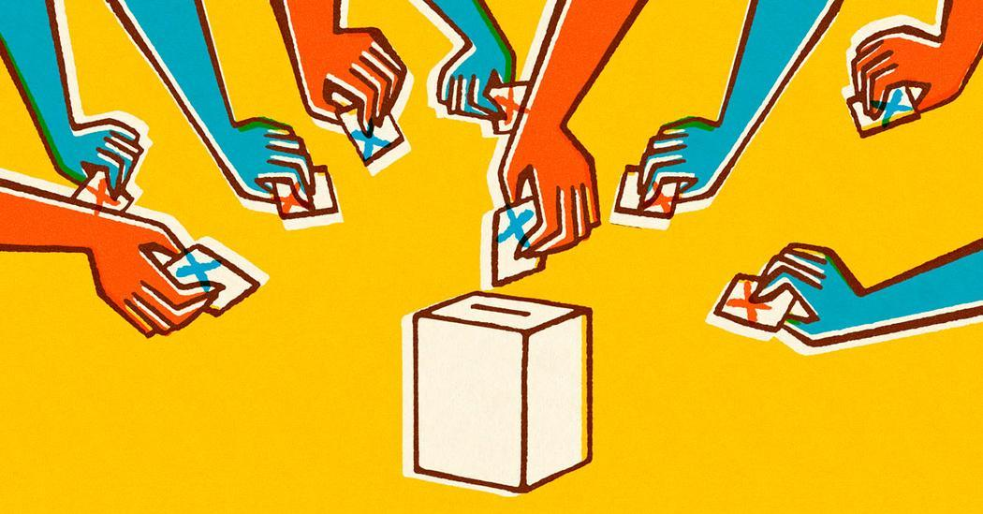
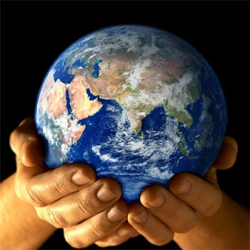
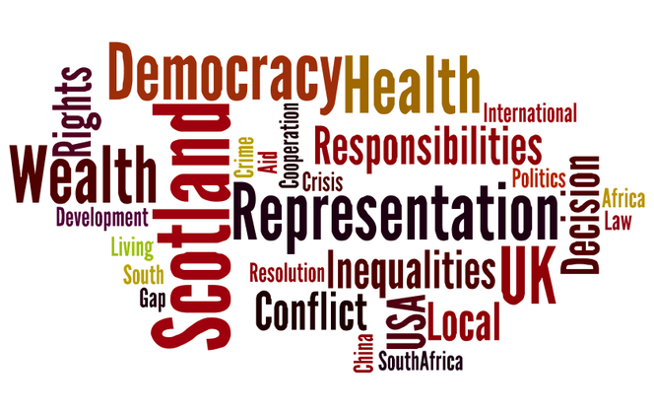
Modern Studies
Welcome to Modern Studies at Garnock Community Campus!
Modern Studies is a subject taught to all S1 and S2.
When you are in S2 you can then decide whether you would like to learn more about Modern Studies in S3 and can choose the subject or choose something else.

Slide 2
What is Modern Studies and what will we learn?
Modern Studies teaches you about the world you live in.
Modern Studies helps you to understand some of important issues in the world today.
In Modern Studies in S1, you will be looking at different aspects of society and learning about important issues happening across the world.
You will learn about;
Scotland
Rights and Responsibilities
Democracy
Sustainable Development Goals

Slide 3
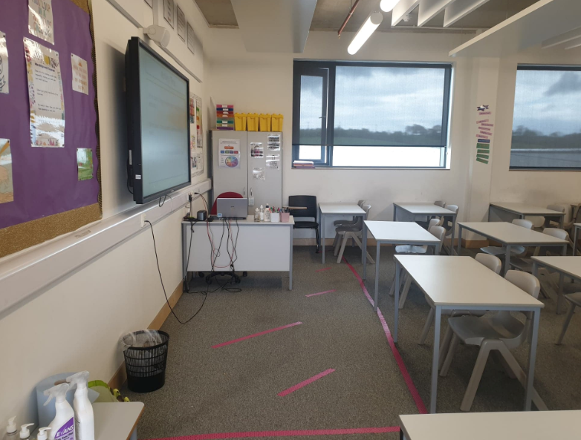
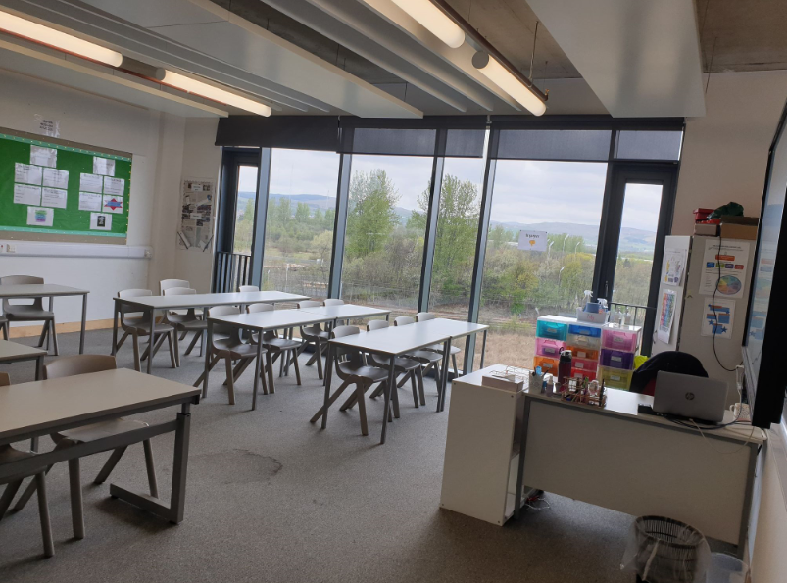
Who teaches Modern Studies?
When you come to Garnock, you will be taught by one of these teachers;
Miss Sloan
Miss Finn
Miss Millar
Miss Bridgewood
This is a photo of Miss Bridgewood and Miss Sloan’s room.
This is a photo of Miss Finn’s room.

Slide 4
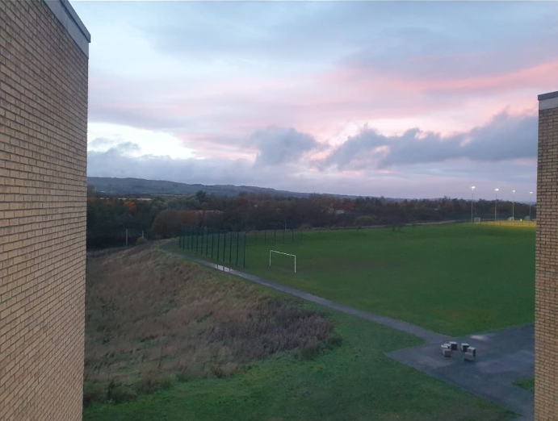
Where is Modern Studies in the school?
We teach Modern Studies in the Social Subjects department.
This is on the third floor of the school, which is right at the top.
There are two flights of stairs to climb and there is a lift for those who need it too.
The views from our floor are amazing!

Slide 5
Poster Activity
To help prepare you for what to expect in Modern Studies, you are going to create a poster on 3 influential people from anywhere in the world.
You should complete your own research to find the following;
3 influential people and who they are
Where they are from
What they are known for
Include your own opinion: Why do you think they are influential? Are they influential to you or others?
Your poster must include a title, pictures and colour.
Look at the example poster and on the following slide.
You can use the template to help you if you would like.
You can do this on paper or on a laptop.

Slide 6
What does influential mean?
Influential means to have an influence on people.
Someone who is influential might inspire or encourage people.
Individuals might look up to influential people.
They may follow their lead and can even be inspired to do things such as make a positive change or even buy items that they buy themselves, sell or like.

Slide 7
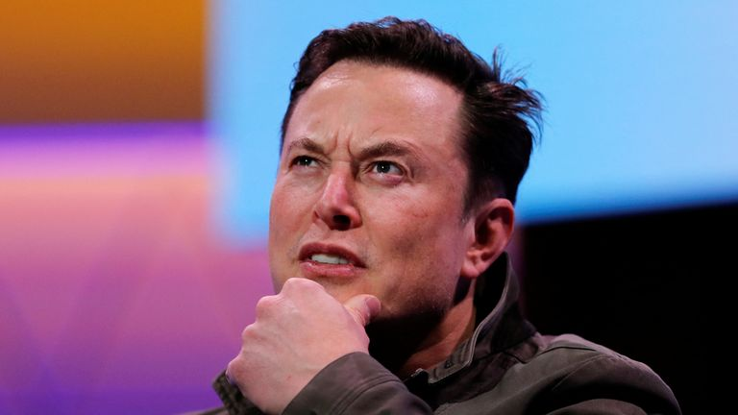
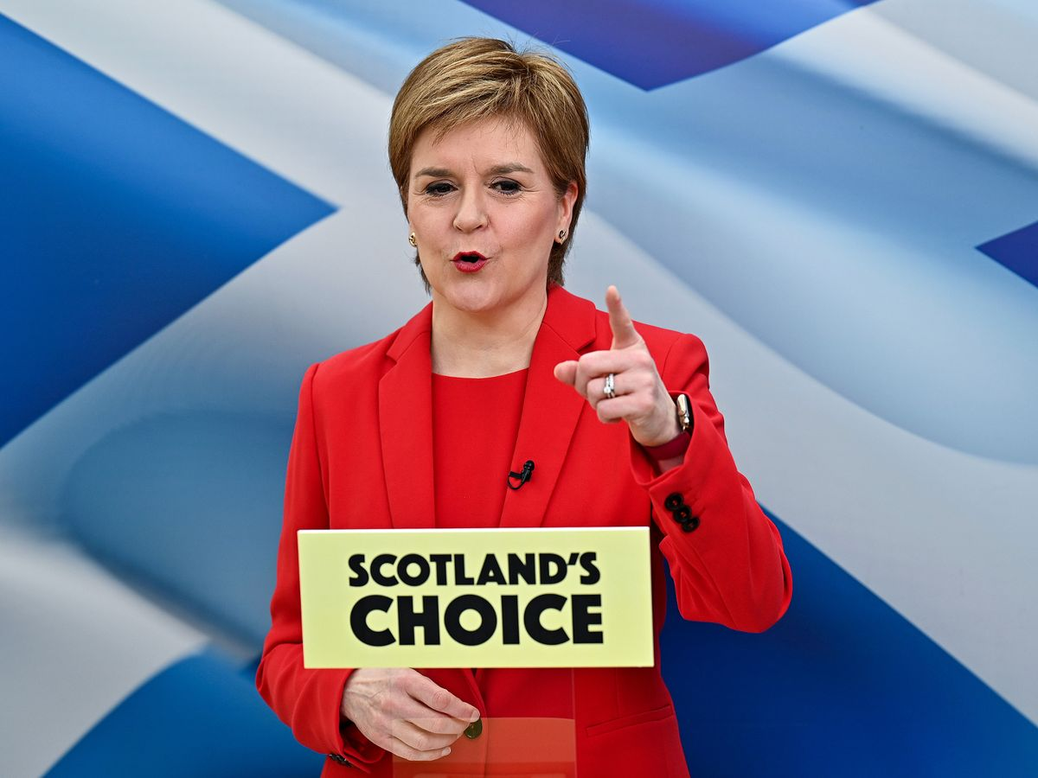
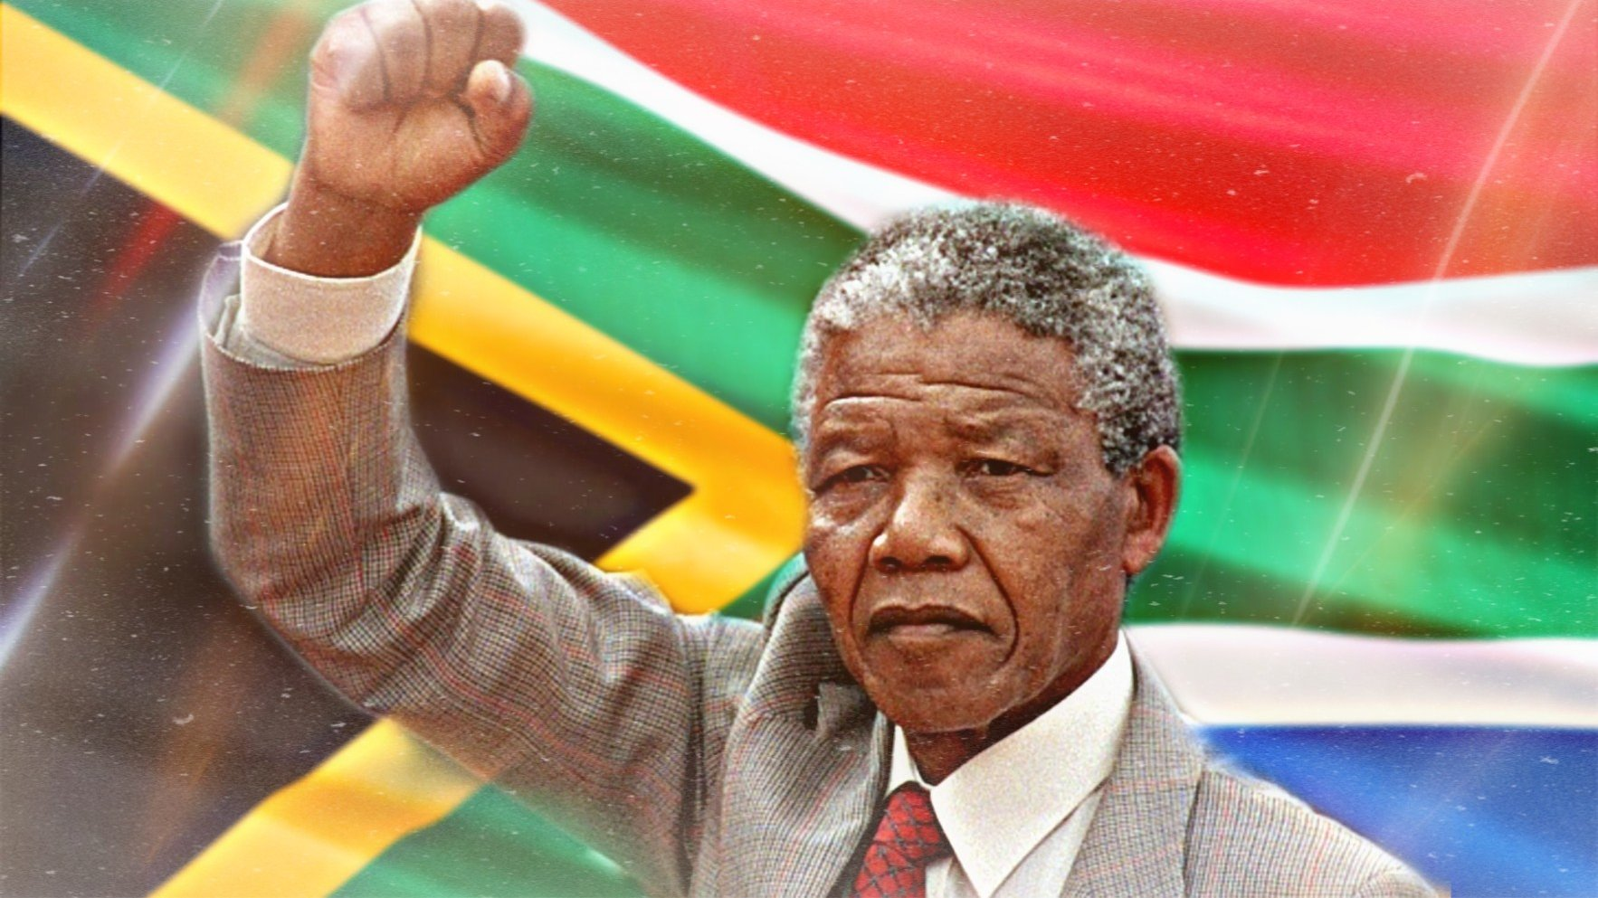
Example Poster
Influential People around the World
Who is this?
Who is this?
Who is this?
Elon Musk is the world’s richest man.
He is an American and was born in South Africa.
Elon is most known for his companies, TESLA and SpaceX.
He is seen as influential by many because he has helped people to get into space and sells electronic cars to millions.
Nelson Mandela was from South Africa.
He died in 2013 but before this he massively influenced people as he was a revolutionary and a political leader.
He fought to end apartheid, which separated black and white people in South Africa. I think he is influential because he helped to make a change for the better.
This is Nicola Sturgeon who is from Irvine in Scotland.
She is the First Minister of Scotland and leads the SNP party.
She is very influential because she is the person who makes the decisions for Scotland.
Members of the public are influenced by her and chose to elect her party, the SNP, to run Scotland.

