Slide 1
P7 Transition Language and Literacy Faculty ENGLISH My Autobiography

Slide 2
Learning intentions: - We are going to be learning what the word Autobiography means, as well as researching information about ourselves and sharing this with your English teacher.
Before we begin to write our own Autobiography there are three questions we want to ask ourselves.
(1) What is an Autobiography..?
(2) Where does the word Autobiography come from ..?
(3) What does the word Autobiography mean..?

Slide 3
(1) What is an Autobiography..?
“A history of a person's life written or told by that person.”
Here are some examples of famous Autobiographies written for young adults..?

Slide 4
2) Where does the word Autobiography come from ..?
The word Autobiography comes from the Greek language.
(3) What does the word Autobiography mean..?
The word autobiography means αὐτός-autos self + βίος-bios life + γράφειν-graphein to write.
When you add these three parts of the meaning together you get a definition of, a book about the life of a person, written by that person.
αυτοβιογραφία

Slide 5
Now that you know what an Autobiography is, where the word comes from and what it means, you can begin to research your own life. Your autobiography will be split into the following sections.
WHO AM I
HOME LIFE
THE BEST THINGS ABOUT BEING ME
WHERE I CALL HOME
TIME LINE
ACROSTIC POEM
FAMILY COAT-OF-ARMS

Slide 6
WHO AM I
This part of your autobiography is about who you are. It could include the following information about you:
What is your full name..?
What is your date of birth..?
Where you were born..?
What weight you were when you were born..?
What time you were born at..?
What is your hair/eye colour?
What style of clothes do you like to wear..?

Slide 7
HOME LIFE
This part of your autobiography is about your home life. It could include information about:
The members of your immediate family and their names.
Ages of members of your house.
Your relationship with the people you live with.

Slide 8
THE BEST THINGS ABOUT BEING ME
This part of your autobiography is about you as a person. It could include information about:
Sports, hobbies or interests you like to take part in.
Your personality, things that are likeable about you.
Your favourite foods.
Your favourite book.
Your favourite type of music.

Slide 9
WHERE I CALL HOME
This part of your autobiography is about your house. It could include information about:
The town/village you live in.
The street you live in.
Your house and in particular, your bedroom and the things in it you like the most.

Slide 10
TIME LINE
This part of your autobiography is about a timeline of your life so far. It could include information about:
When you were born..?
Your first word..?
The first time you walked..?
Your first day at primary school..?
The birth of any younger siblings..?
Your first holiday..?

Slide 11
TIME LINE

Slide 12
AROSTIC POEM
This part of your autobiography is a creative task using the letters of your name and adjectives to best describe you as a person. It could look like this:
SOPHIE
S IS FOR…
O IS FOR…
P IS FOR…
H IS FOR…
I IS FOR…
E IS FOR…
JAMES
J IS FOR…
A IS FOR…
M IS FOR…
E IS FOR…
S IS FOR…

Slide 13
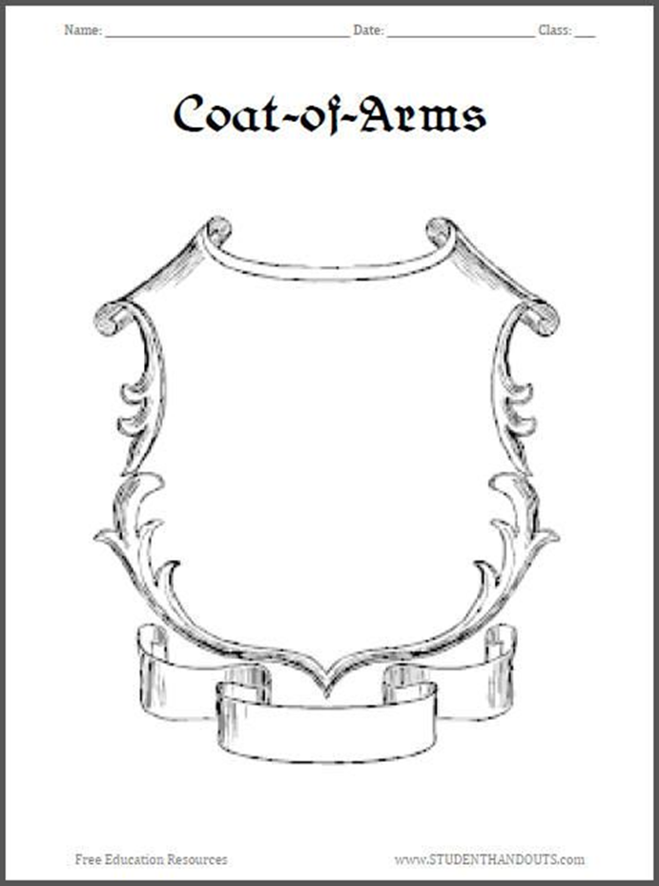
FAMILY COAT-OF-ARMS
This part of your autobiography is a creative task designing your family coat-of-arms. It could look like this and include the following information:
A picture that represents your personality.
A picture which represents your favourite hobby or something you like to do in your spare time.
A picture to represent your favourite book or the last book you read.
Your full name at the bottom.

Slide 14
Task:
Now that you have completed the research, timeline and family coat-of-arms for your Autobiography it is time to share this with your new S1 English teacher.
You can share your autobiography in any format. You could create a word document, or a power point or you could complete your autobiography on paper and then take picture. Post your autobiography on the P7 English Google Classroom for your English teacher to read.
Good Luck P7s.
Your English teacher is looking forward to finding out all about you.

