Slide 1
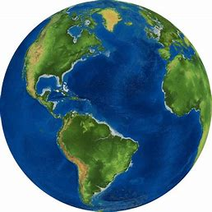
Welcome to the Geography Department

Slide 2
What is vexillology ?

Slide 3
It is …..
The study of the history, symbolism and usage of flags or any interest in flags in general.
The word comes from the Latin word vexillum (“a flag") and the Greek word -logia (“to study").
A person who studies flags is a vexillologist, a person who designs flags is a vexillographer, and the art of flag-designing is called vexillography

Slide 4
Today, you are all going to be vexillographers and do some vexillography !

Slide 5
So..lets see how good your flag knowledge is ?

Slide 6
Afghanistan
Australia
Canada
Iceland
Italy
Belgium
Argentina
Switzerland

Slide 7
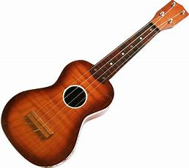
Your Transition Task
Today I would like you to draw a flag which represents (or symbolises) you.
Your design should include some objects that symbolise who you are or what you find enjoyable or important and which will tell me something about you.
If you like football ….
If you like music…

Slide 8
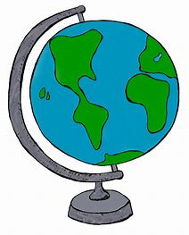
I would like you to add your name to your flag (in a particular place) so that by the end of this task, you will also have made a name plate for bringing with you to my class in August!

Slide 9
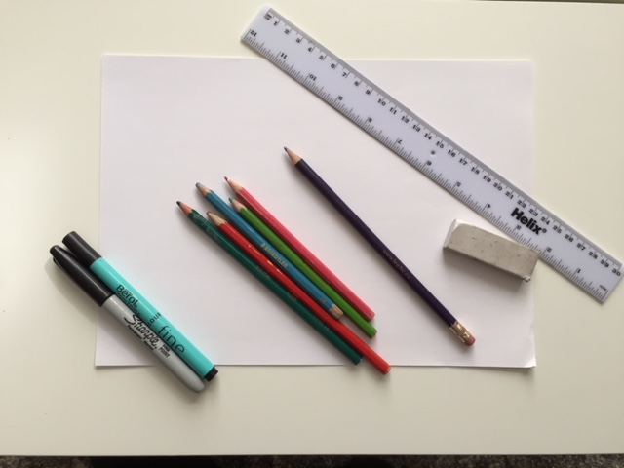
Resources you might need for this task
The paper will be made into your flag name plate

Slide 10
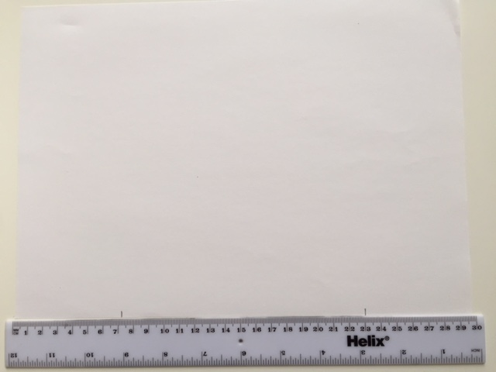
Put your A4 paper or card or cereal box cardboard in landscape and your ruler along the bottom long edge. Put pencil mark as shown
Make a pencil mark at 7cm and 23cm
7 cm
23 cm

Slide 11
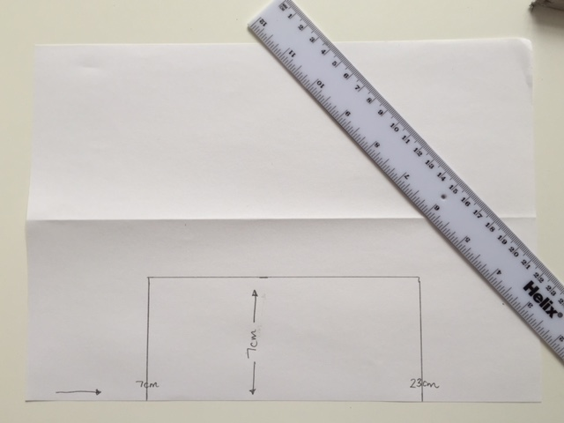
Add another mark at 7cm from the bottom edge and make a rectangular box
7 cm

Slide 12
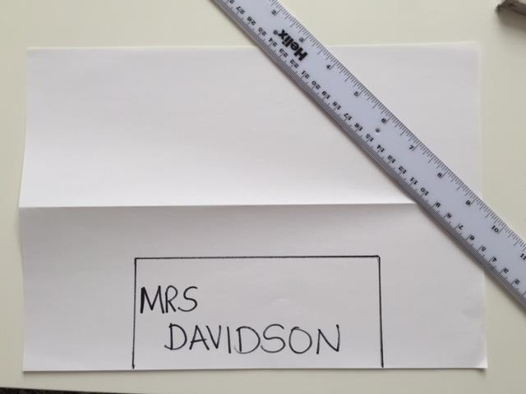
Write your first name in the rectangle you have created.

Slide 13
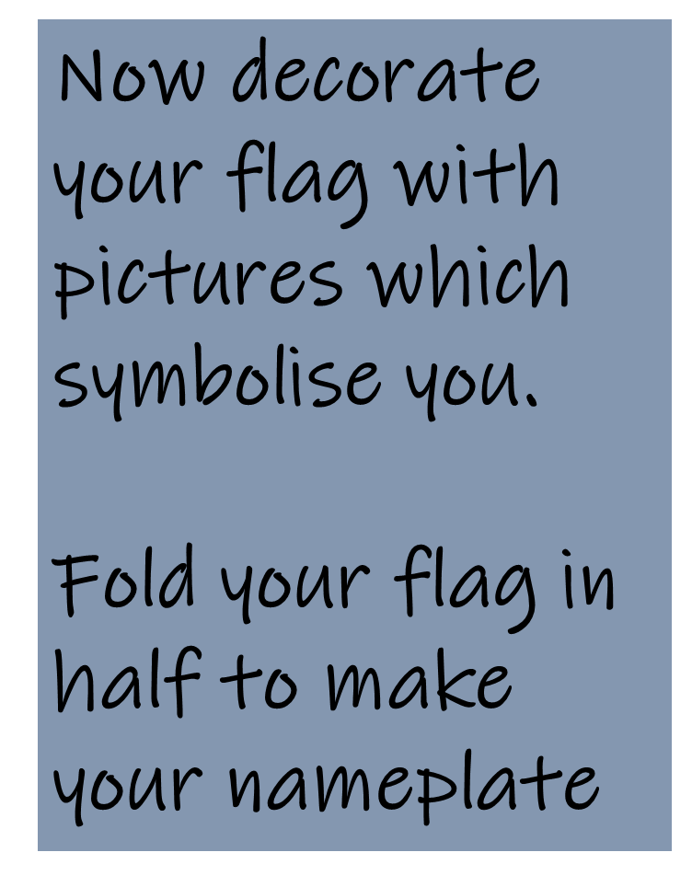
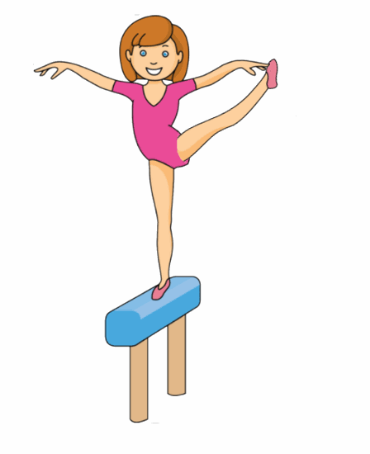
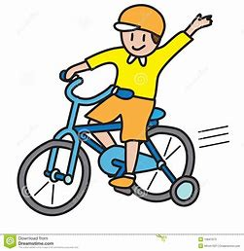
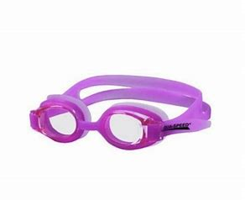
YOUR FIRST NAME

Slide 14
