Slide 1
P1 Induction
Session 20-21
Mrs Ross-Hays

Slide 2
School Day
Start time - 8:50 am
Morning Break – 10:20 am - 10:40 am
Lunch Time – 12 noon - 12:40 pm
End of School Day - 2:50 pm
(There might be slight changes to these times in Aug 2020 due to Covid-19. We will
make you aware of any revised times as soon as possible.)

Slide 3
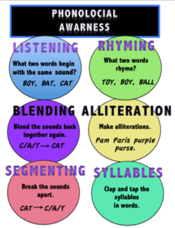
Literacy
Phonological Awareness
Phonological Awareness
Phonological awareness is a skill that allows children to recognise and work with the sounds of spoken language. In school, it means being able to pick out rhyming words and count the number of syllables in a name, etc.

Slide 4
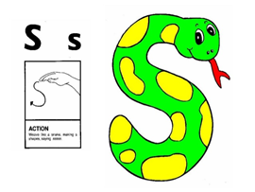
Literacy -
Phonics
Phonics/Sounds
Jolly Phonics
We use the Jolly Phonics resources to teach sounds. Each sound has an action and a song to help the children remember the sound made by each letter. The sounds are not learned in alphabetical order.

Slide 5
Literacy -
Reading
BugClub
Our main reading resource is BugClub and this can be accessed online and in real book format. The books all have parent help guides inside the front and back covers to help you support your child’s reading at home.

Slide 6
Literacy -
Tricky Words
We introduce whole words in Primary 1 – we call these our “Tricky Words”. These are words which are difficult to sound out and are best learned as sight vocabulary or whole words.

Slide 7
Numeracy and Mathematics
We use Heinemann Active Maths as our main resource, but we draw from many other resources.
In Primary 1, lots of our learning happens through play within the classroom.
The children will learn number recognition, 1 to 1 correspondence, subitising, addition, subtraction, 2D and 3D shape, information handling, time, etc.

Slide 8
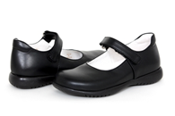
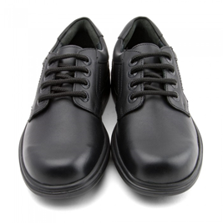
Uniform
Put your child’s name on everything!
Black trousers/skirt
Black shoes
Pale blue polo shirt
Grey school jumper/cardigan
White shirt and school tie
Blazer
Gym Kit – black short and black plimsolls

Slide 9
Any questions?????
Email us on garnock@ea.n-ayrshire.sch.uk

