Slide 1
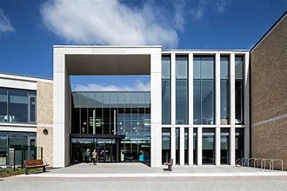
Garnock Community Campus
Moving from Primary to Secondary School is an exciting, but sometimes scary time! A new building, new rules, new teachers, new routines and new friends are just some of the changes you will experience but this booklet will help you get used to some of the routines and features of your new school!
School image
Use the powerpoint to help you complete this booklet. Some of the tasks give you important information about starting secondary school – other are just for fun!
School logo

Slide 2
Draw a self portrait here.
Name:
Birthday:
My Primary School:
Eye Colour:
Hair Colour:
Height:
Favourite Colour
Favourite Animal
If I could have a superpower, I’d….
Favourite School Subject
Best place I’ve ever been to…
Dream country to visit…
If I could travel back in time, I’d go to…
My dream job is…

Slide 3
Life is a journey! Think back through primary school and write down your favourite memories or events that have shaped you to become the amazing person you are!

Slide 4
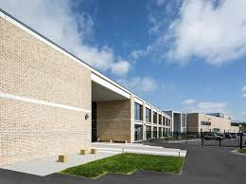
Full Name of the School
School Address
School Telephone Number
Name of the Head Teacher
School Starts at
School Finishes at
I will get to school by
How long will it take you to get to school?
What time will you have to leave home?
Add 10 words around the image below to describe your new school .
School image

Slide 5
List three things you are most excited about moving to Garnock Community Campus
List three things you are a little worried/nervous about
List three things you would like to know about Garnock Community Campus
List three things or people which will help you when moving to secondary school
List three differences between your primary school and Garnock Community Campus

Slide 6
Find the subjects below in the Word search – they are vertical, horizontal and diagonal!
M | A | F | S | E | H | M | G | E | O | H | I | M | J | E | E | A
T | M | A | M | W | S | L | U | S | M | P | S | E | T | T | I | S
R | U | P | A | E | C | E | Z | S | A | C | P | N | U | H | A | I
A | F | G | T | R | D | P | W | R | I | I | A | G | T | I | N | U
H | S | R | H | P | G | R | T | E | N | C | I | T | O | C | A | O
J | T | A | S | L | U | B | N | Y | R | A | N | E | R | S | S | L
T | U | B | J | E | I | C | Q | L | E | R | M | X | T | A | S | S
E | E | A | U | H | E | M | U | A | H | S | U | D | I | N | E | P
N | F | X | L | G | E | O | G | R | A | P | H | Y | M | D | M | A
G | I | M | T | V | M | A | I | T | Y | E | O | A | E | M | B | N
L | O | A | I | D | R | A | M | A | R | T | T | S | C | O | L | I
I | P | T | R | E | L | G | R | D | U | O | E | R | A | R | Y | S
S | P | U | F | O | S | E | E | K | R | M | P | T | T | A | E | H
H | I | S | T | O | R | Y | S | C | S | A | S | M | E | L | R | A
E | N | J | V | E | P | I | F | J | N | O | M | U | R | S | B | K
J | K | R | E | G | I | S | T | R | A | T | I | O | N | P | U | M
Y | Z | X | T | L | S | V | Z | C | O | M | P | U | T | I | N | G
Maths
English
Science
Geography
History
Art
Music
PE
Drama
Technical
PSE
HE
Computing
RE
Spanish
Assembly
Registration

Slide 7
Match up the subject to the correct icon
Maths
English
Science
Geography
History
Art
Music
PE
Drama
Technical
French
HE
Computing
RE
Spanish
PSE

Slide 8
 | Monday | Tuesday | Wednesday | Thursday | Friday
Registration 09.00-09.10
Period 1 09.10-10.00
Period 2 10.00-10.50
BREAK 10:5—11.05
Period 3 11.05-11.55
Period 4 11.55-12.45
LUNCH 12.45-13.25
Period 5 13.25-14.15
Period 6 14.15-15.05
Period 7 15.05-15.55
What lesson do you have period 5 on Thursday?.......................................
Who is your PSE teacher? ………………………..
How many minutes does each lesson last? …………………………………
How long is registration?………………………………………………………..
How long is lunch and break combined? …………………………………...
Where is PE? ……………………………………………………………..
How many times a week do you have the following:
Maths: ………………………………..
English: ……………………………….
PSE: ……………………………….
Which days will you need your PE kit? ………………………………………………………………………………

Slide 9
At secondary school, you will be moving around to different classrooms for different lessons. You could be in 7 classrooms in one day. This means that you need to bring all the equipment you will require with you for the day. You can keep larger items such as your PE kit in your locker, however you can only go to your locker before school, at break and lunchtime and at the end of the day. Below are some items you will need to bring – can you identify them and add anything else?

Slide 10
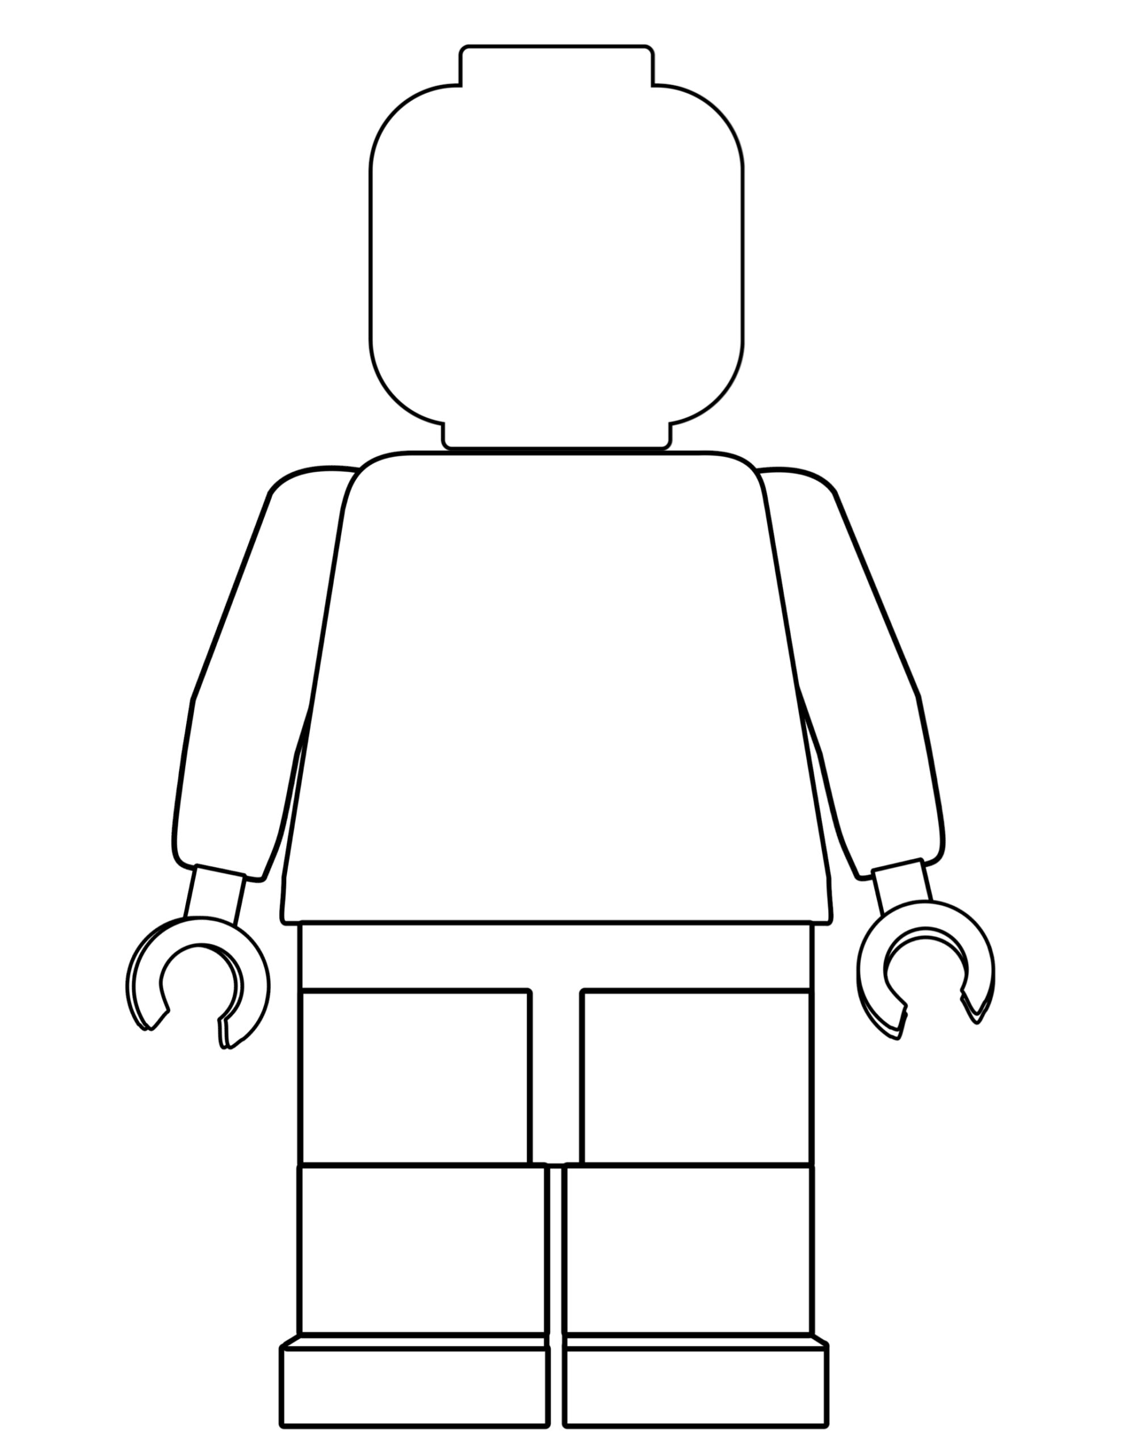
One of the different things about moving to secondary school is the change in what you will wear. At Garnock Community Campus, we pride ourselves in looking smart and professional at all times. Use the school website or the information booklet to draw and label the school uniform you will wear onto the Lego figure
Why is wearing the correct school uniform important?
…………………………………………………………………………………………………………………………………………………………………………………………………………………………………………………………………………………………………………………………………………………………………………………………………………………………………………

Slide 11
Getting to Garnock Community Campus safely is just as important as being there. In the box below, draw the route you are going to take to school (whether that’s walking, cycling, driving or by bus). Identify spots where there could be hazards (e.g. busy roads) and explain how you will manage this safely!

Slide 12
Promoting Positive Relationships
Our Promoting Positive Relationships Policy applies to the way we choose to conduct ourselves, the way that we behave towards other people, and the way that we behave in our lessons.
They are expectations, because we are expected to behave in this way; it is not a choice.
The expectation that we have is that we all behave in a way that means that we are calm, collected and respectful towards one another, and that we arrive for our lessons on time and prepared.
Punctual & Prepared
Respectful & Responsible
Do you have any other ideas to add?
PPR
Turning up on time to lessons
Working successfully as part of a team
Being respectful of other peoples beliefs
Wearing the correct uniform
Contributing to lessons
High level of respect shown to all
Saying good morning to people as you pass
Supporting others
Holding the door open
Having a pen, pencil and ruler in lesson
Consistent punctuality over the whole year
Helping with younger pupils
Acting as a positive role model
Going above and beyond with your work
Staying calm if something goes wrong
Being respectful to other staff and students
Sitting with someone who is alone at lunch
Apologising if you have done something hurtful
Discussing issues with a teacher
Remembering your homework
Giving someone a compliment
Asking for help when needed

Slide 13
School Values
In Garnock Community Campus, we have six values. These are: Creativity, Determination, Respect, Responsibility, Teamwork and Achievement.
In the boxes below, write or draw an example of what you think you do, or could do, to demonstrate these values.
DeCCC

Slide 14
When you go to Secondary School, you will learn a huge number of new skills, and improve skills you have practiced in Primary School. In the goal below, use the list to write in 10 new skills or things you’d like to build on in your years at Secondary School.
Be in a school production | Speak another language | Represent your school in a national competition
Learn to play a musical instrument | Volunteer in the local community | Travel to another country
Play for a school team | Learn how to survive in the wild | Take care of the school garden
Learn how to manage money | Taste food from another country | Try camping
Cook a new meal from scratch | Read new books | Take part in a fancy dress day
Create a piece of art | Raise money for charity | Become Head Boy or Girl
Learn how to read a map | Join an after school club | Learn to dance
Use computers to create your own website | Learn First Aid | Improve your singing
Make new friends from other schools | Work as part of a team | Something else?

Slide 15
After secondary school, you can move onto college or an apprenticeship and then to University or into a job! It’s normal not to know what you want to do yet but this is a chance for you to have a think about your dream jobs!
Icons to represent that job:
Icons to represent that job:
Icons to represent that job:

