Slide 1
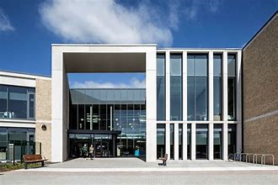
Garnock Community Campus
P7 Transition
ATTENDANCE MATTERS

Slide 2
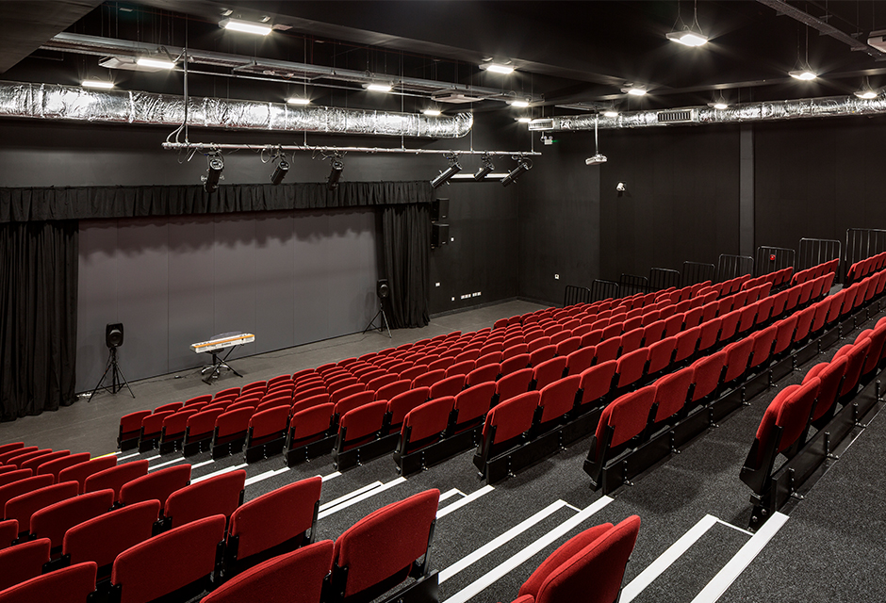
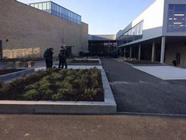
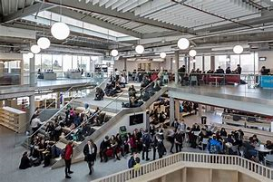
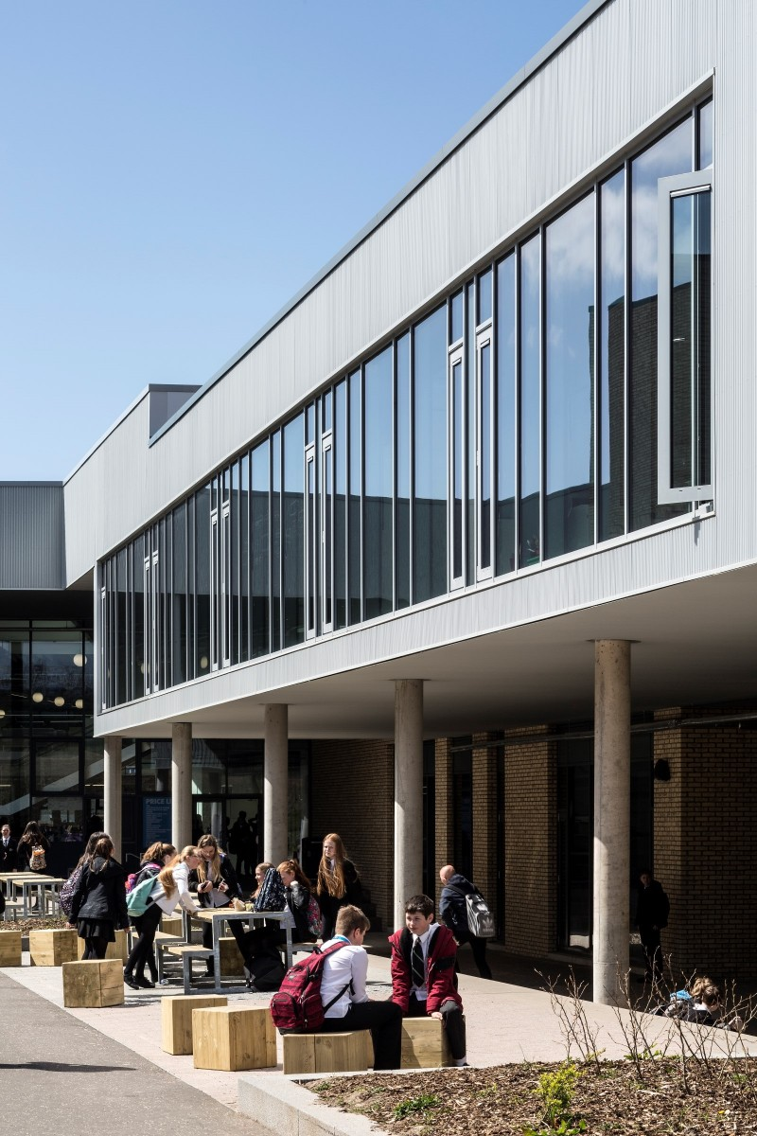
P.S.E
Personal &
Social Education
ATTENDANCE MATTERS

Slide 3
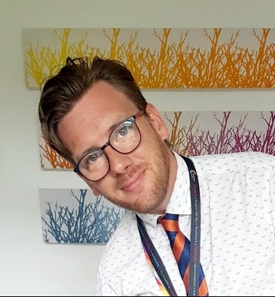
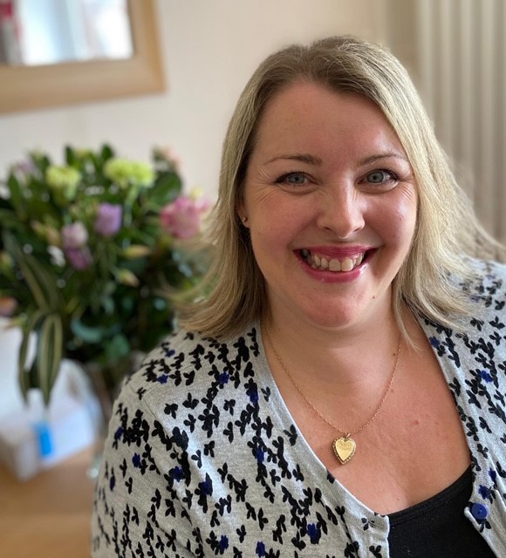
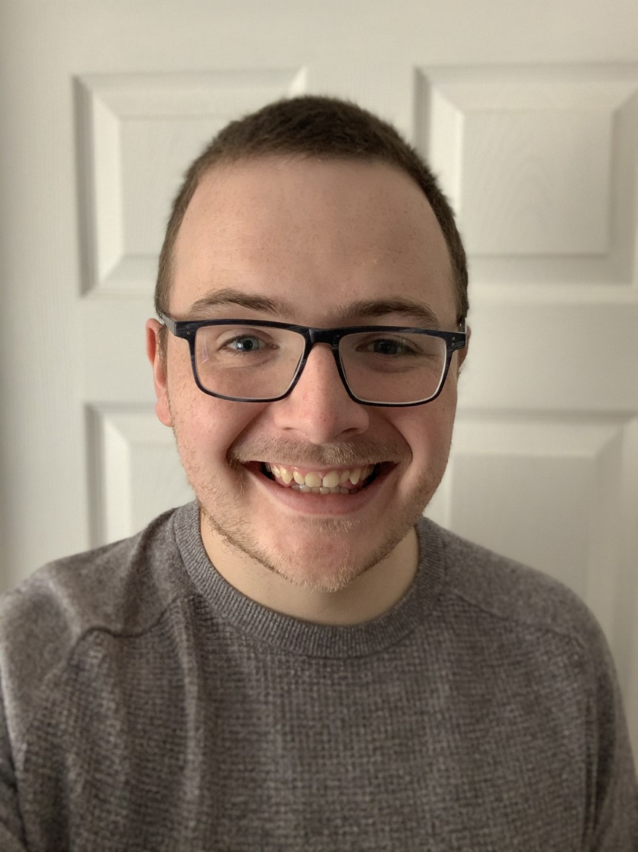
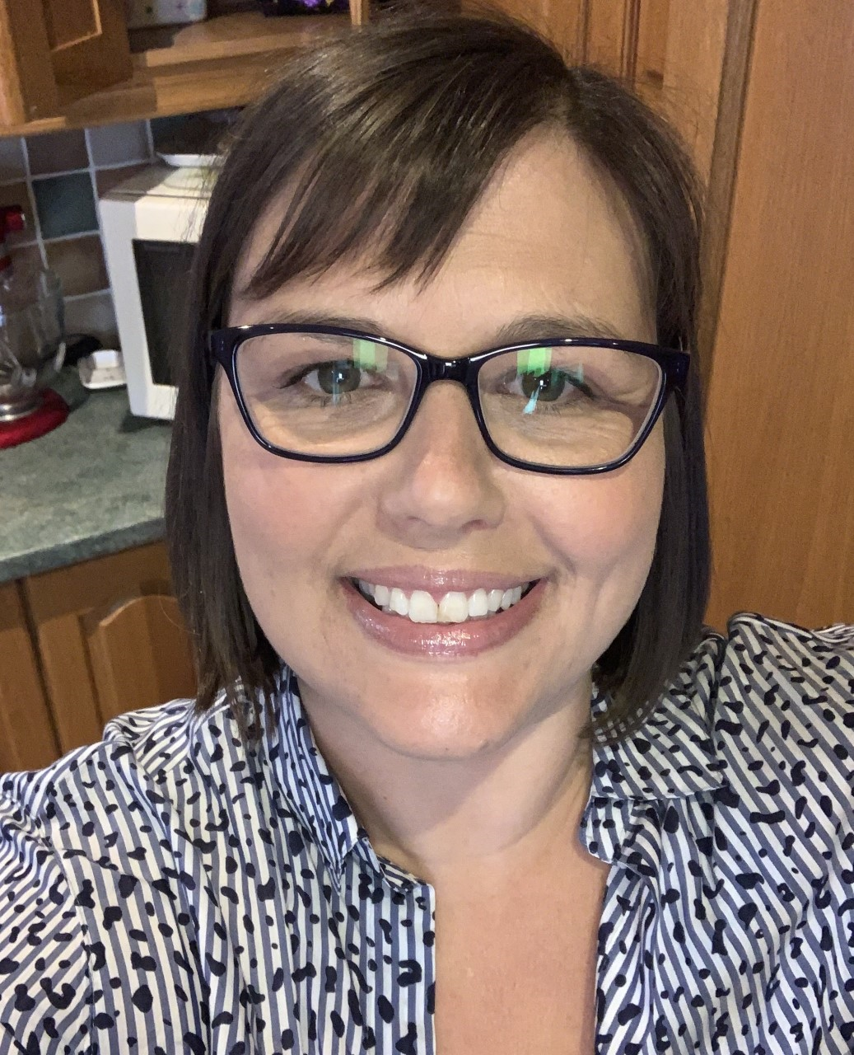
Meet our Pastoral teachers
Mr Brown
ISLAY
Mrs Watson
HARRIS
Mr McLean
CUMBRAE
Mrs Stirling
ARRAN
ATTENDANCE MATTERS

Slide 4
All about us…
Name | Mrs Stirling
House | Arran
House colour | Blue
Subject | PE
Pets | Dog
Best place I’ve been | Bahamas
Name | Mr McLean
House | Cumbrae
House colour | Green
Subject | Technical
Pets | No pets
Best place I’ve been | New York
Name | Mrs Watson
House | Harris
House colour | Purple
Subject | English
Pets | 2 cats
Best place I’ve been | Italy
Name | Mr Brown
House | Islay
House colour | Red
Subject | Biology
Pets | No pets
Best place I’ve been | South Africa
ATTENDANCE MATTERS

Slide 5
PSE lessons
During S1 you will cover a variety of topics in PSE
Settling in Healthy eating
Social media Sleep
Relationships Resilience
Anti – bullying Careers
Growth mindset My World of Work
Road Safety Target setting
ATTENDANCE MATTERS

Slide 6
Your story so far… p
Have you ever received a certificate?
Have you ever won a prize?
What do you think you’re really good at?
Have you represented your school in a competition?
Have you had a leadership role as a house captain?
Do you play sport for a team?
Use this to help you complete pages 2, 3 & 4 of the booklet
ATTENDANCE MATTERS

Slide 7
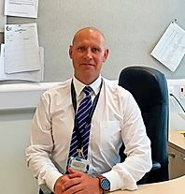
FACTFILE
Name: Garnock Community Campus
Address: Beith Road
Glengarnock
KA14 3BF
Phone: 01505 682685
Head teacher: Mr Dick
Start time: 9am
Finish time: 3.55pm Monday & Tuesday
Finish time: 3.05pm Wednesday, Thursday & Friday
Use this to help you complete p4 of the booklet
ATTENDANCE MATTERS

Slide 8
Example S1 timetable
Use this to help you complete pages 8 & 9 of the booklet
S1 timetable
 | Reg | 1 | 2 | Interval | 3 | 4 | Lunch | 5 | 6 | 7
 | 9.00 | 9.10 - 10.00 | 10.00 - 10.50 |  | 11.05 - 11.55 | 11.55 - 12.45 |  | 1.25 - 2.15 | 2.15 - 3.05 | 3.05 - 3.55
Monday |  | Modern Studies | PE |  | Art | PSE |  | English | Science | Maths
Tuesday |  | Art | French |  | English | RE |  | Maths | Science | Geography
Wednesday |  | English | Technical |  | History | French |  | Maths | PE
Thursday |  | Computing | Music |  | English | Drama |  | Technical | Maths
Friday |  | PSE | English |  | Science | Maths |  | Music | French
FUNKY TUNES
BOFFIN
ATTENDANCE MATTERS

Slide 9
Large image slide
A Guide to making new friends
TOP TIPS!
Smile
Ask questions
Be kind
Join new clubs
Try new things
Accept we are all different
Be a good listener
Treat others as you expect to be treated
Avoid gossiping at the expense of others
Find out what you have in common
Use this to help you complete p12 of the booklet
ATTENDANCE MATTERS

Slide 10
Our school
Stay controlled and realise the potential impact your actions
may have.
Step out with your comfort zone, express yourself and think outside the box.
Responsibility
Creativity
Determination
Teamwork
Learn to get past each other’s differences, work and share ideas together, whilst listening and helping one another.
Never let anything get in
your way, keep trying, stay
positive and don't give up.
Respect
Accept that everyone is unique and has their own personality
Achievement
Successfully reach your goals and achieve your dreams
Use this to help you complete p13 of the booklet
ATTENDANCE MATTERS

Slide 11
What would you like to achieve at Garnock?
Join extra curricular clubs?
Gain qualifications?
Make new friends?
Learn new skills?
Represent the school?
Join the school band?
Take part in a school show?
Have a leadership role?
Use this to help you complete p14 of the booklet
ATTENDANCE MATTERS

Slide 12
FREQUENTLY ASKED QUESTIONS
1 | What will I do if I get lost going to classes? | Do not panic, ask a member of staff to help you.
2 | What should I do if I feel ill in school? | Tell your teacher and someone will take you to the medical room.
3 | Who should my parents phone if there is a problem? | Your Pastoral teacher
4 | If I have a problem when I’m at school, who would I tell? | Your Pastoral teacher
5 | Where do you eat lunch? | Dinner hall in open area
6 | Where are the toilets? | There are boys and girls toilets in most departments
7 | How can I make new friends? | Join clubs in school to meet new people
8 | How will I find my way around the school to begin with? | Buddies will help you to begin with
ATTENDANCE MATTERS

Slide 13
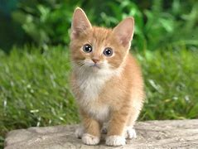
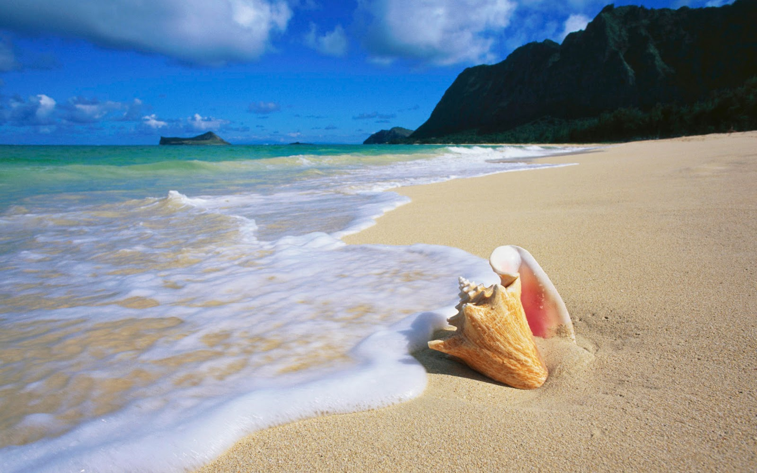
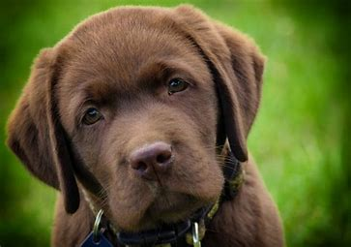
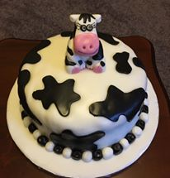
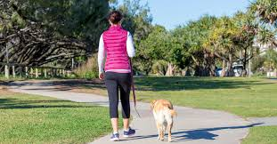
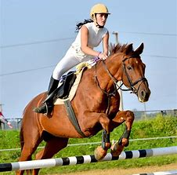
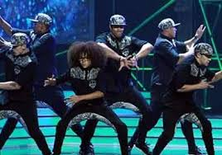
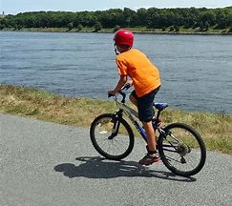
Things that make us happy…
Health & Wellbeing
ATTENDANCE MATTERS

Slide 14
How can you earn house points?
Excellent attendance
Inter-house activities
Competitions in school
Representing the school
Good behaviour
Achievements outwith school
Being kind
Attending extra curricular activities
Being a house ambassador
ATTENDANCE MATTERS

Slide 15
ATTENDANCE MATTERS

