Slide 1
P7 Transition Language and Literacy Faculty MFL All about me

Slide 2
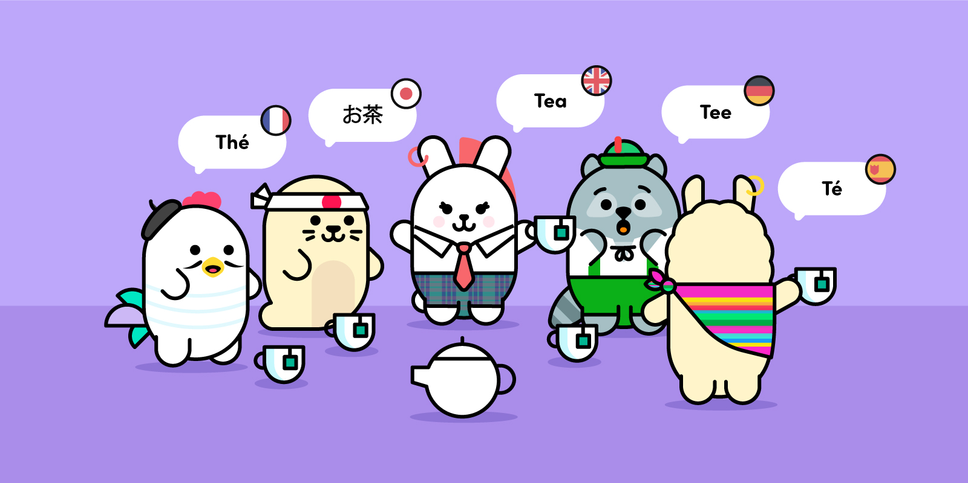
Learning intentions: - We are going to be revising/learning to talk about our favourite things in French and Spanish and use our prior learning to help us to complete a treasure hunt at home!!
Before we begin we would like to see just how much you can remember from primary school from your MFL lessons…

Slide 3
On y va!
Can you think of ALL of the French phrases and words that you have covered so far at Primary school? Set yourself a timer for 5 minutes and…GOOOOO!!!
HINT: Think in topics that you have studied, so can you list everything that you know about family, pets, colours etc…?
Le Français

Slide 4
¡Vamos!
Can you think of ALL of the Spanish phrases and words that you have covered so far at Primary school? Set yourself a timer for 5 minutes and…GOOOOO!!!
HINT: Think in topics that you have studied, so can you list everything that you know about family, pets, colours etc…?
Español

Slide 5
Phew! That took a lot of brain power to try and remember all those words!
Now it’s time to get creative and let us know a little bit more about you and the things you like. We would like you to create a piece of bunting that includes some of your favourite things. The next couple of slides will give you some vocabulary to help you.
Task:
1. Choose which language you prefer (you can do both if you’re struggling to chose.
2. Print, copy or draw your own bunting (see word documents attached)
3. Fill in your favourite things
4. Make it nice and colourful
5. Bring it to school with you when we return!
We will then make a class bunting that will represent all the pupils in each class ☺

Slide 6
Français
Matières = l’espagnol, le français, la géo, les SVT, l’EPS, l’histoire, les maths, la musique, l’anglais, l’art
Nourriture = la pizza, les nuggets de poulet, les frites, le chocolat, les bonbons, l’hamburger, le fromage, la glace
Animaux = hamster, souris, serpent, chat, chien, cochon d’Inde, lapin, lézard, cheval
Couleurs= rose, rouge, orange, jaune, vert, bleu, noir, blanc, violet
Name
Birthday
Town
Class
Self-portrait
My favourite things
Food
School subject
Colour

Slide 7
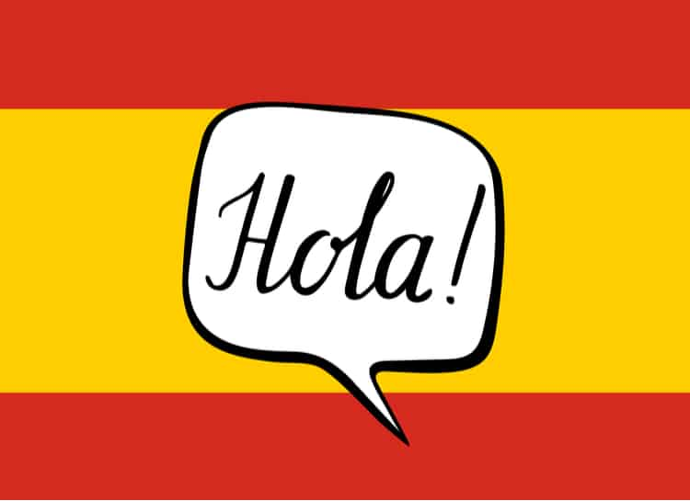
Español
Asignaturas = el español, el francés, las ciencias, la historia, las matemáticas, la música, el inglés, el dibujo
Comida= la pizza, los nuggets de pollo, las patatas fritas, el chocolate, los caramelos, las hamburguesas, el helado
Animales = hamster, ratón, serpiente, gato, perro, cobaya, caballo, conejo
Colores = rosa, rojo, naranja, amarillo, verde, azul, negro, blanco
Name
Birthday
Town
Class
Self-portrait
My favourite things
School subject
Food
Colour

Slide 8
We cannot wait to see your designs and find out all about the things that you like!
Now for the real challenge!
This treasure hunt challenge has been set in French as we start off S1 learning how to introduce ourselves in French.
If you don’t know a lot of French and are looking for some help we suggest using the website www.wordreference.com which is an online dictionary. We are looking forward to seeing what you manage to find in your homes.
À vos marques, prêts, partez !

Slide 9
La chasse au trésor dans ta maison!
E.g. Trouve quelque chose de bleu – Find something blue…
Trouve quelque chose de blanc –
Trouve quelque chose de rouge –
Trouve quelque chose de jaune –
Trouve quelque chose de vert –
Trouve quelque chose d’orange –
Trouve quelque chose du jardin –
Trouve quelque chose de la chambre –
Trouve quelque chose de la cuisine –
Trouve quelque chose du salon –
Top Tip!
All of the items you need to find are either a certain colour or from a certain room in the house.
Have a look around your house and take a photo of each description – make a collage with all your photos. Send your work to us via Google Classroom.
Bonne chasse!

